Slide 1
Implementation of Item Management System in Online Games using Blockchain Technology
4조
2014105085 정재훈
2014105061 원응호
2014105044 서창호
2014105030 노경환
Notes:
발표 준비 시스템 개요도, 역할분담, 면담사진, 논문 초안 및 계획 10p 분량

Slide 2
Index
Architecture
Tools
Project Plan
Roles
Paper draft

Slide 3

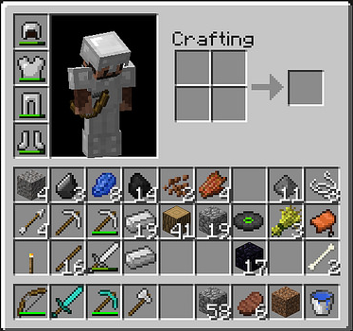






Architecture
<game>
User 1
GAME
LOG
User 2
with

Slide 4



Tools

Slide 5
Project Plan
 |  |  |  |  |  | 기간 강조 표시: | 3 |  |  | Planned period |  |  |  |  |  | Actual starting date |  |  |  |  | completion rate
 |  |  |  |  |  |  | Period |  |  |  |  |  |  |  | actual(overdue) |  |  |  |  |  | % completion(overdue)
 | Activity | Planned Starting Week | Planned Period | Actual Starting Week | Actual Period | Completion Rate | Sep |  |  |  |  | Oct |  |  |  |  | Nov |  |  |  | Dec
 |  |  |  |  |  |  | 1 | 2 | 3 | 4 | 5 | 6 | 7 | 8 | 9 | 10 | 11 | 12 | 13 | 14 | 15
 | First Meeting with Mentor | 1 | 1 | 1 | 1 | 100%
 | Writing Paper | 1 | 2 | 1 | 2 | 100%
 | Plan Presentation | 2 | 2 | 2 | 2 | 100%
 | Design Demo game | 3 | 2 |  |  | 0%
 | Design Contraction | 3 | 2 |  |  | 0%
 | Implementing demo games | 5 | 8 |  | 6 | 0%
 | Implementing System | 5 | 2 |  | 8 | 0%
 | Implementing Server | 5 | 2 |  | 6 | 0%
 | Implementing Private Blockchain | 5 | 8 |  | 3 | 0%
 | Implementing DB | 5 | 4 |  | 6 | 0%
 | Extracting Log Data | 6 | 5 |  | 7 | 0%
 | Distributing Log Data with Block Chain | 9 | 4 |  | 8 | 0%
 | Testing Demo game | 10 | 3 |  | 3 | 0%
 | Testing Whole System | 13 | 3 |  | 7 | 0%
Notes:
유니티 게임
인벤토리 구현
서버 구현
로그 추출
로그 트랜잭션
게임 동작 테스팅
프라이빗 블록체인 구현
트랜잭션 확인

Slide 6
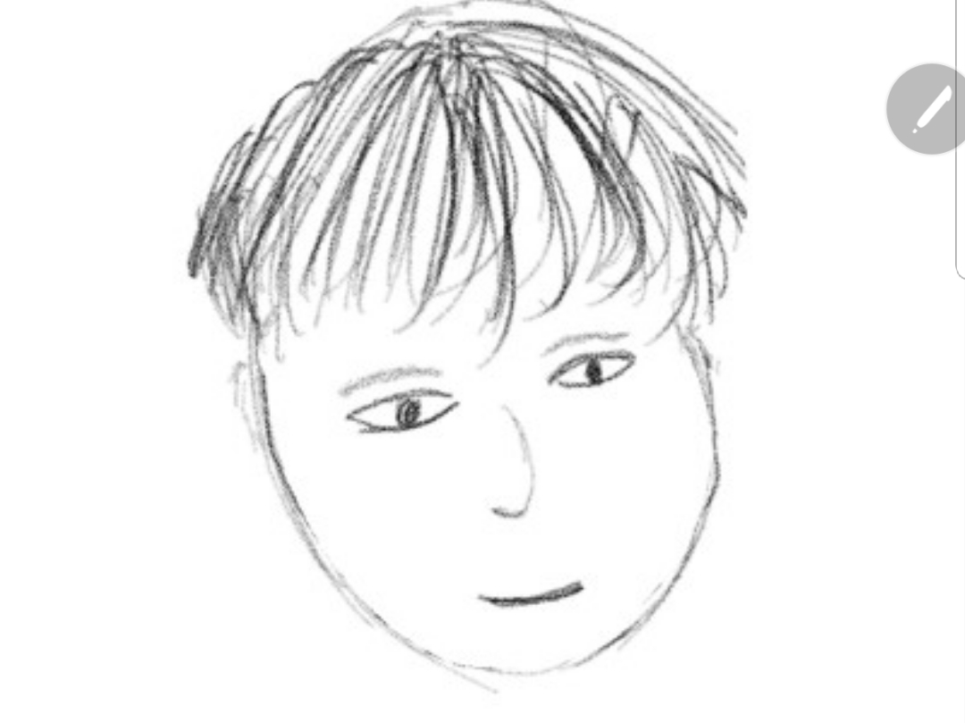
Roles
Jeong Jaehun
Extracting and storing log data
Won Eungho
Monitoring Blockchain System
Implementing contraction of Blockchain
Seo Changho
Noh Kyunghwan
Designing and Implementing demo game
Implementing and managing of Server
Testing
Implementing and managing of System
Team Leader
Implementing DB of demo game

Slide 7
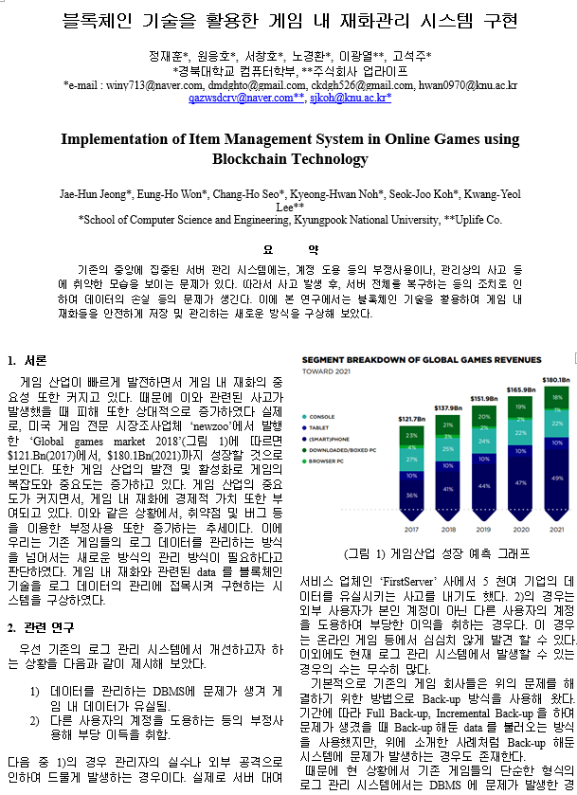
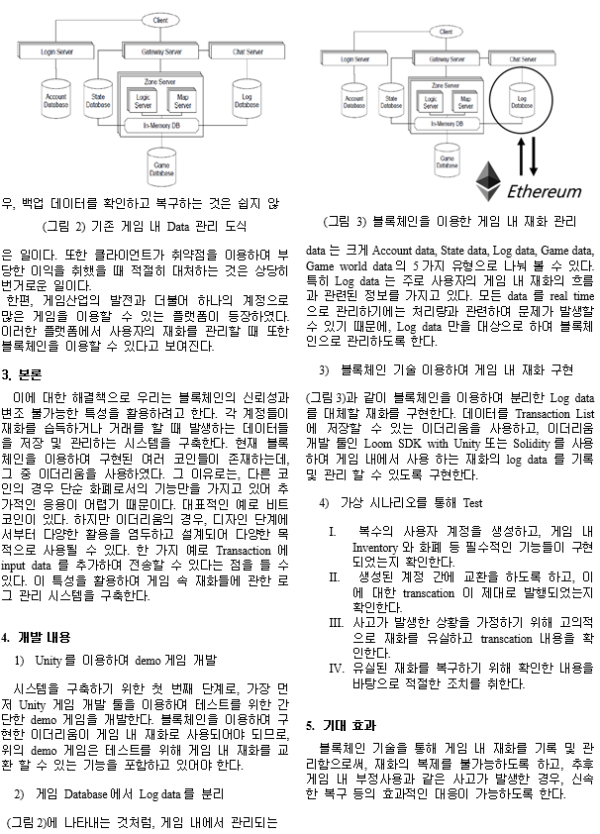
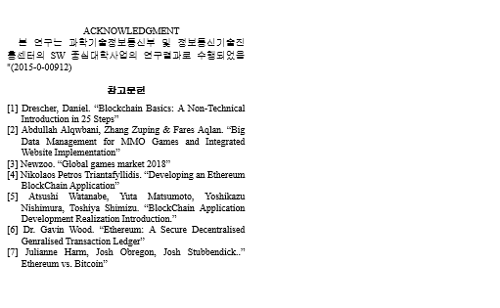
Paper draft
9/17 KIPS – submitted

Slide 8
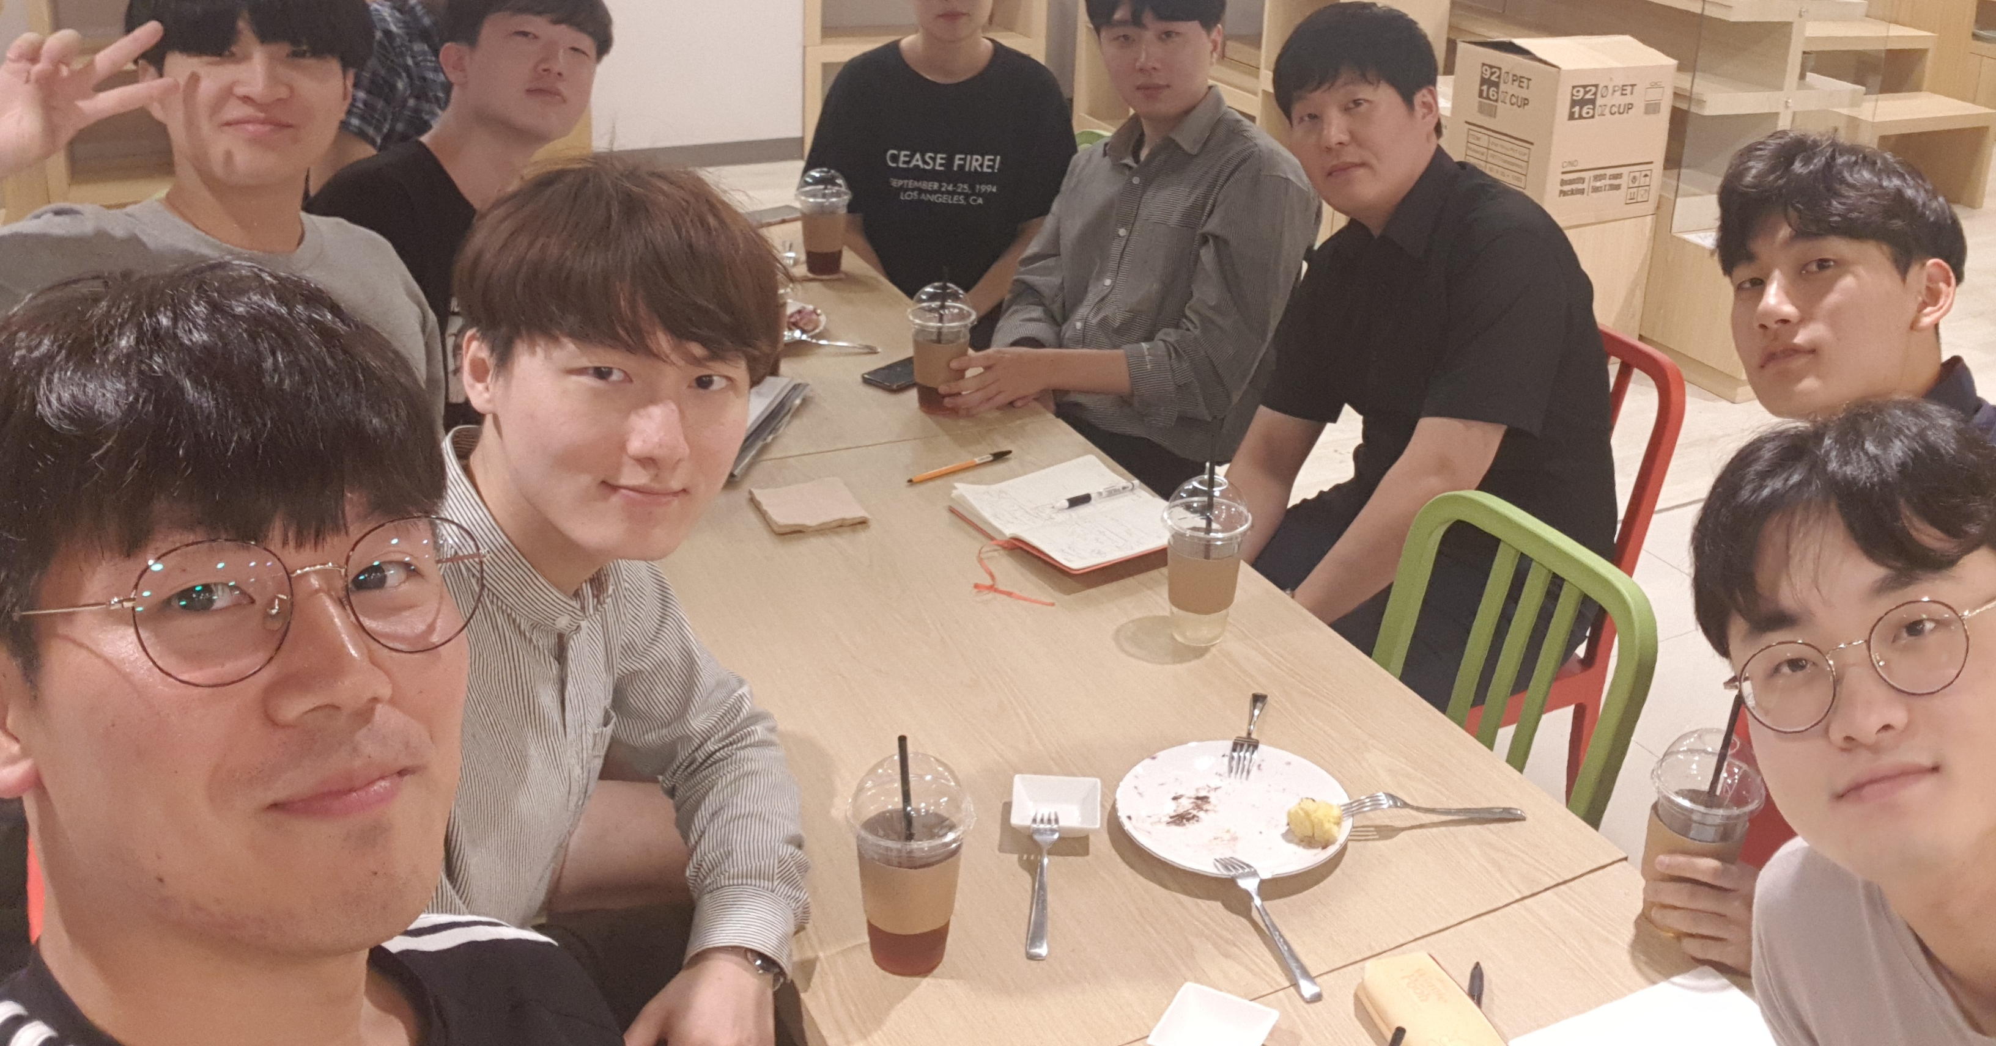
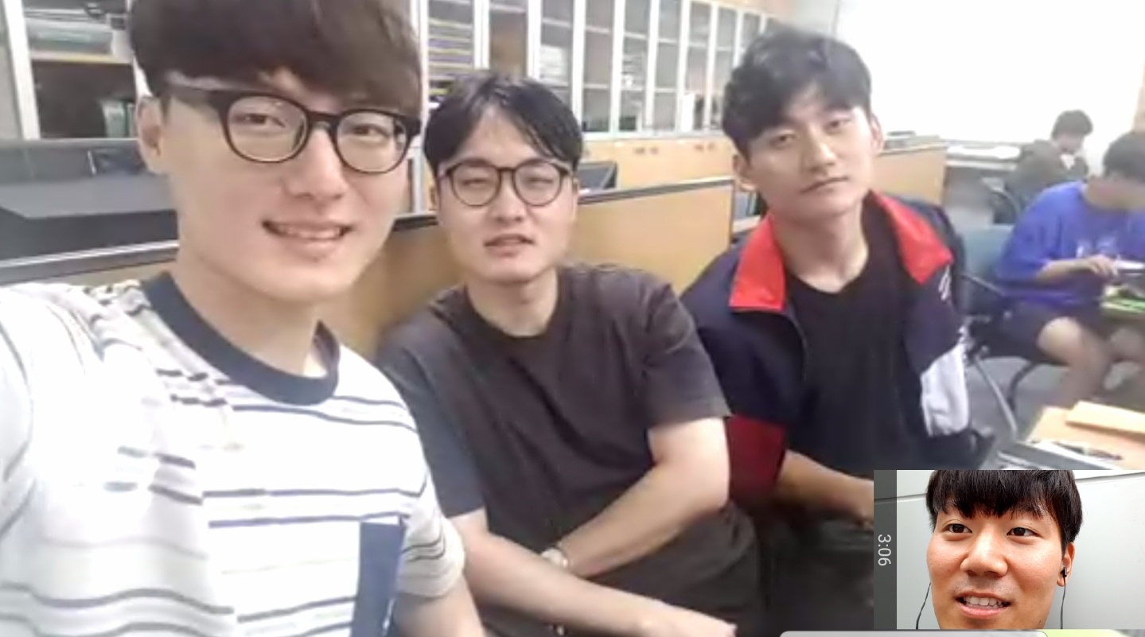
Pictures of meeting
9/7 Meeting
9/16 Meeting

